Slide 1
Updates on Deliverables
2/25/2015
Previous Meeting Notes: https://docs.google.com/a/tamu.edu/document/d/1HbppBRyV3oRo_8PoG-29SCA0nc-L-3X-fQ1ihrE6VWk/edit

Slide 2
Lotanna

Slide 3
Matthan
https://github.com/Bladeroybal/SeniorDesign/wiki

Slide 4
Cameron- SAR vs GPR in Image Processing
Both actively use a time delay from transmitter to receiver to measure reflected signals and the location of terrain.
SAR treats the terrain or area of interest as a Gaussian Field
GPR uses lower frequency RF signals to penetrate the ground. This leads to the need for a slicing theorem when imaging to calculate exactly how deep into each slice the signal penetrates before reflected.
There are two types of GPR, time domain where nanosecond pulses are transmitted and the returns are digitized at a certain frequency sampling rate. The other is frequency domain GPR where single frequencies are transmitted and the amplitude of the reflected signals are measured.
The depth that a GPR signal will penetrate depends on the length of the wave and the hardness of the ground. SAR does not deal with penetration and the wave will simply reflect once they hits an electrically different material (ground in this case).
SAR can be imaged in 2D, while GPR requires a z component for the depth of signal.
SAR and GPR use similar filters and techniques to clean up the data and to reconstruct an image, including fourier transformations and matched filters.
One may difference in the hardware side of the data aquisition is that the time delay will be more difficult to deal with in GPR, and the signal will need to be amplified once received.

Slide 5
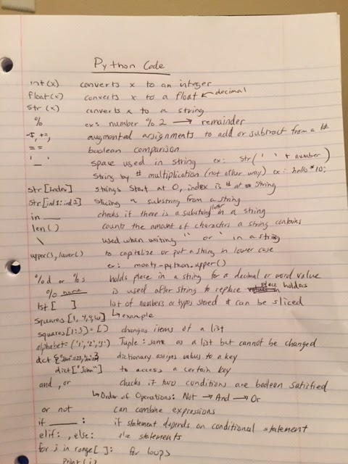
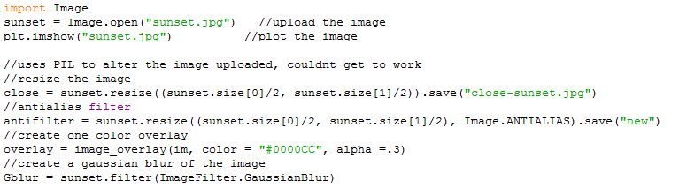
Python Coding/Setup
This Week
Found problems dowloading numpy & opencv onto personal computer. There is a problem with the compatibility with the new version of python.
Completed the python introduction and downloaded all of the proper software, including PyCharm
Currently working on developing a program to import an image and put the image through a series of filters.
Current problem in downloading the image processing modules to Python so that I can write code to upload and alter an image.
For Next Week
Complete two files of python: one to import an image, create an array for the data points of the image, and to filter the image for clarity. The Second will upload a set of data points and reconstruct an image from the points.

Slide 6
Blade - Differences between SAR and GPR
 | Frequency | Typical Range | Type | Issues
SAR | 8GHz-12GHz (see notes) | azimuth=½(l of antenna) not distance | Pulses | Requires exact knowledge of flight path and velocity
GPR | 10MHz-1GHz | 1m at 300MHz -3.3GHz UWB | Pulses | Potentially heavy antenna
Notes:
MIT OCW Operates at 2.4 GHz. GPR uses ultra-wideband radar now.

Slide 7
Blade - Horn Antennas and GPR Purchasables
Horn Antenna - Used for UHF > 300MHz
Wide Bandwidth (10:1 - 20:1)
Gain: 10-20dBi
For as low as 300MHz, can weigh upwards of 20lbs
GPR Purchasables - Tend to lay on the ground
Horn Antennas used penetrate roughly up to 3 ft.
Buying book Ultra-Wideband, Short-Pulse Electromagnetics
Texas A&M Dissertation - CMOS INTEGRATED CIRCUIT DESIGN FOR ULTRA-WIDEBAND TRANSMITTERS AND RECEIVERS

Slide 8
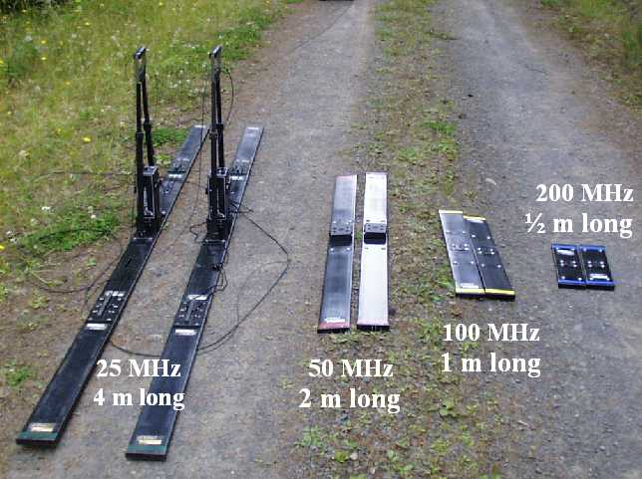
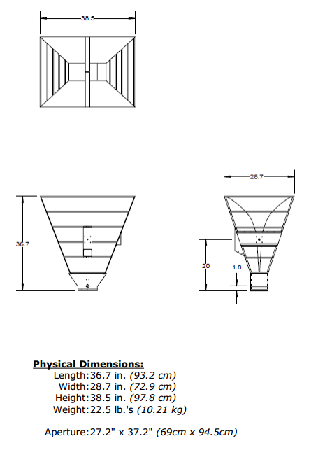
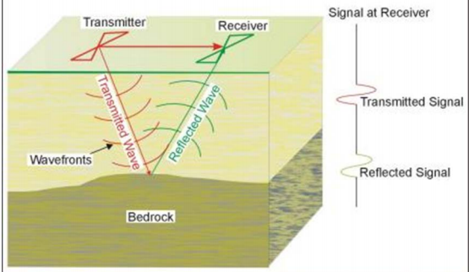
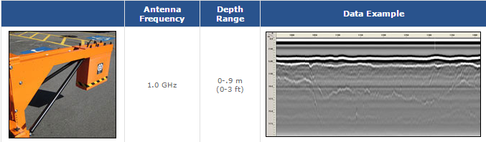

Slide 9
Links
http://www.ahsystems.com/catalog/SAS-570.php
http://www.radartutorial.eu/20.airborne/ab07.en.html
http://en.wikipedia.org/wiki/Synthetic_aperture_radar
http://people.uwec.edu/jolhm/Past_Students/Wenell/whatisgpr.htm
http://ocw.mit.edu/resources/res-ll-003-build-a-small-radar-system-capable-of-sensing-range-doppler-and-synthetic-aperture-radar-imaging-january-iap-2011/projects/MITRES_LL_003IAP11_proj_in.pdf
http://www.geophysical.com/antennas.htm
https://www.wpi.edu/Pubs/ETD/Available/etd-031108-203800/unrestricted/hparikh.pdf
http://people.uwec.edu/jolhm/desertsouthwest/Posters/ArikGPR.pdf
http://repository.tamu.edu/bitstream/handle/1969.1/ETD-TAMU-2009-08-833/XU-DISSERTATION.pdf?sequence=3
http://www.antenna-theory.com/antennas/aperture/horn.php

